Slide 1



MAPPING ADVERSARY EMULATION PLANS USING THE MITRE ATT&CK,CALDERA,ANSIBLE AND SPLUNK
République Tunisienne
Ministère de l’Enseignement Supérieur et de la Recherche Scientifique
Université de Tunis El Manar
Institut Supérieur d’Informatique
Realized within the SAMA PARTNERS BUSINESS SOLUTION
Realized by :
Professional supervisors :
Academic supervisor:
Feriel DARRAGI
Mr. Belhassen JERBI
Mr.Ahmed JOUINI
Mrs. Nihel BEN YOUSSEF
Academic year:
2021-2022
Notes:
Madame la présidente de jury, madame messieurs les members du jury, je tiens tout d’abord à vous remercier pour l’intérêt que vous avez bien voulu porter à
mon travail en acceptant de faire partie de ce jury. C’est un honneur pour moi que d’avoir l’occasion de discuter du résultat de mon projet de fin d’étude intitulé « Etude et mise en place d’un cloud privé pour les collectivités locales » réalisé par moi-même Hiba TOUIHRI et encadré par par Mme Safa REJICHI et M. Sofiene HEMISSI.

Slide 2
Motivation: Technology keeps improving as do hackers
Present
+15,1% The average number of cyberattacks and data breaches
From 2020 To 2021
2019
China Chopper web shell
2017
CVE-2019-0604:Microsoft SharePoint Remote Code Execution Vulnerability
The attackers installed additional web shells
77,000 web shell
46,000 distinct machines
20% Phishing
WannaCry Ransomware
2016
Worm + Ransomware.
More than 200,000 computers
150 countries have been affected
300 $ per system
Mirai Botnet
2014
22% Malwares
Mirai variants are typically used for brute force attacks on IoT devices
600,000 vulnerable IoT devices
Peak throughput of 1.1 Tbps
Heartbleed
1989
Heartbleed: vulnerability in OpenSSL
Nearly 500,000 servers were vulnerable
CYBORG Ransomware
EVERY 11 SEC a ransomware attack occurs
The first known ransomware attack targeted the healthcare industry
Source: Forbes magazine
2
Notes:
It appears that for every action an enterprise makes to secure itself from cyber-attacks, or for
every new anti-hacking tool developed, the hackers come up with something more intricate to
make it more dicult to defeat them.
Looking back over 20 years, the hackers that come to mind are amateur college kids. Gradually the field of piracy begins to evolve, for example in 1997 we find the ...
Then in 2004 we found
In the beginning of 2007 we started talking about
Just 3 years later, new concepts are introduced like
In these days, the cyber attack to evolve so that it affects all areas like banks, android devices, etc.
According to forbes magazine, The average number of cyberattacks and data breaches From 2020 To 2021 has evolved 15.1% of which 20% are malware and 22% are phishing attacks

Slide 3
Motivation: Problematic and limitations
Lack of Framework dedicated
to mapping rules
04
Multiple techniques used
by hackers
01
05
Multiple sources of Logs
Problematic and limitations
02
06
Complexity of implementation of rules
Multiple target platforms
03
07
Multiple malicious code
Maturity of security teams
3
Notes:
It appears that for every action an enterprise makes to secure itself from cyber-attacks, or for
every new anti-hacking tool developed, the hackers come up with something more intricate to
make it more dicult to defeat them.
Looking back over 20 years, the hackers that come to mind are amateur college kids. Gradually the field of piracy begins to evolve, for example in 1997 we find the ...
Then in 2004 we found
In the beginning of 2007 we started talking about
Just 3 years later, new concepts are introduced like
In these days, the cyber attack to evolve so that it affects all areas like banks, android devices, etc.
According to forbes magazine, The average number of cyberattacks and data breaches From 2020 To 2021 has evolved 15.1% of which 20% are malware and 22% are phishing attacks

Slide 4
Motivation: Context of Project and Proposed solution
SAMA PARTNERS BUSINESS SOLUTIONS
Proposed solution
IT & Engineering Consulting Company
Founded in 2010
70 employees
Specialized in Cyber and Information Security
Headquarter in Mannheim Germany, offices in Munich (Germany) and Tunis (Tunisia)
Certified according to ISO/IEC 27001: 2013
Operates its own Cyber Security Academy offering several security courses and certifications
Operates its own Security Operation Center (SoC) as a service
Goal 03: Emulate several Windows attack scenarios using emulation tools
Goal 05: Automate installation and configuration
Goal 01: Collect windows events log
01
03
05
02
04
Goal 02: Inject Windows log files to SIEM Solution
Goal 04: Build a library of adversary emulation plans and Create appropriate correlation rules
.
Scope of the project
This project interest only to windows use cases (is one of 6 parts of big project)
The goals of this project is not to enumerate all windows use cases
4
Notes:
It appears that for every action an enterprise makes to secure itself from cyber-attacks, or for
every new anti-hacking tool developed, the hackers come up with something more intricate to
make it more dicult to defeat them.
Looking back over 20 years, the hackers that come to mind are amateur college kids. Gradually the field of piracy begins to evolve, for example in 1997 we find the ...
Then in 2004 we found
In the beginning of 2007 we started talking about
Just 3 years later, new concepts are introduced like
In these days, the cyber attack to evolve so that it affects all areas like banks, android devices, etc.
According to forbes magazine, The average number of cyberattacks and data breaches From 2020 To 2021 has evolved 15.1% of which 20% are malware and 22% are phishing attacks

Slide 5


PLAN
4
5
3
Conclusion and perspectives
1
2
Realization and Implementation
Solution Experimentation
State of the art
Architecture of The Target Solution
Test and validation of correlation rules
Mapping rules with MITRE ATT&CK
Test and validation of correlation rules
Mapping rules with MITRE ATT&CK
Comparative Study of SIEM Solutions.
Threat hunting framework
Comparative Study of Emulation platforms
Comparative Study of Configuration management and automation tools
The conception of the architecture of the targeted solution.
Installation of Ansible
Installation of caldera and caldera agent
Installation of Splunk and splunk forwarder
Configuration of Sysmon
Development of Script to inject evtx files to Splunk
Investigation
Implementation of correlation rules.
Automating Installation Using Ansible.
5
Notes:
It appears that for every action an enterprise makes to secure itself from cyber-attacks, or for
every new anti-hacking tool developed, the hackers come up with something more intricate to
make it more dicult to defeat them.
Looking back over 20 years, the hackers that come to mind are amateur college kids. Gradually the field of piracy begins to evolve, for example in 1997 we find the ...
Then in 2004 we found
In the beginning of 2007 we started talking about
Just 3 years later, new concepts are introduced like
In these days, the cyber attack to evolve so that it affects all areas like banks, android devices, etc.
According to forbes magazine, The average number of cyberattacks and data breaches From 2020 To 2021 has evolved 15.1% of which 20% are malware and 22% are phishing attacks

Slide 6
1.State of the art
6
Notes:
It appears that for every action an enterprise makes to secure itself from cyber-attacks, or for
every new anti-hacking tool developed, the hackers come up with something more intricate to
make it more dicult to defeat them.
Looking back over 20 years, the hackers that come to mind are amateur college kids. Gradually the field of piracy begins to evolve, for example in 1997 we find the ...
Then in 2004 we found
In the beginning of 2007 we started talking about
Just 3 years later, new concepts are introduced like
In these days, the cyber attack to evolve so that it affects all areas like banks, android devices, etc.
According to forbes magazine, The average number of cyberattacks and data breaches From 2020 To 2021 has evolved 15.1% of which 20% are malware and 22% are phishing attacks

Slide 7
SIEM tools comparative study
State of the art
Architecture of The Target Solution
Realization and Implementation
Solution Experimentation
Conclusion and Perspectives
 | QRADAR | SPLUNK | LogRhythm | EXABEAM
Founded | 2010 | 2005 | 2003 | 2013
License | Flow Per Minute (FPM) Licensing Event Per Second (EPS) Licensing | indexing volume (GB) | subscription pricing tied to volume consumption | Based on the number of users or on the volume of data
User Behaviour Analytics (UBA) | QRadar User Behavior Analytics (free of cost) | Splunk User Behavior Analytics (Not free of cost) | UserXDR (not free of cost) | Behavior Analytics (Not free of cost)
automated incident response (SOAR) | IBM Resilient SOAR | Splunk Phantom | RespondX | Exabeam Fusion SIEM
Threat Intelligence | X-Force QRadar Threat Intelligence | Enterprise Security Threat Intelligence | Should integrate external threat intelligence tools (Soltra Edge) | Exabeam Threat Intelligence Service is a cloud-based solution
Delivery Model | Deployed on the cloud / the on-premise hardware | Deployed in a cloud /as software on-premise | SaaS solution /Cloud /Web | SaaS solution \ Cloud \Web
Dedicated Hardware | YES | NO | YES | YES
Supported OS | Red hat | Windows ,Linux | Windows ,Linux | Windows ,Linux
Agent | Wincollect for windows | Splunk forwarder | Data Collector | Data Lake
High Availability | YES | YES | YES | YES
Distributed Architect | YES | YES | YES | YES
7
Notes:
It appears that for every action an enterprise makes to secure itself from cyber-attacks, or for
every new anti-hacking tool developed, the hackers come up with something more intricate to
make it more dicult to defeat them.
Looking back over 20 years, the hackers that come to mind are amateur college kids. Gradually the field of piracy begins to evolve, for example in 1997 we find the ...
Then in 2004 we found
In the beginning of 2007 we started talking about
Just 3 years later, new concepts are introduced like
In these days, the cyber attack to evolve so that it affects all areas like banks, android devices, etc.
According to forbes magazine, The average number of cyberattacks and data breaches From 2020 To 2021 has evolved 15.1% of which 20% are malware and 22% are phishing attacks

Slide 8
Threat Hunting, SIEM and Adversary emulation plan
State of the art
Architecture of The Target Solution
Realization and Implementation
Solution Experimentation
Conclusion and Perspectives
SIEM limitation
Threat Hunting: Proactive approach
Threat detection with Windows Event Logs
Threat detection with Adversary Emulation plans
Multiple false positive.
Insufficient understanding of the attack pattern.
security staff should filter through the "signals“.
losing valuable time and resources.
Examining for unknown vulnerabilities and undetected attacks.
Collect and analyze data from numerous sources inside and outside the company
Enable an organization to discover and respond to possible dangers
Mitigate the impact of breach.
Investigate highly developed ready attack scenarios and implement new correlation rules.
Helping to develop new SIEM use cases to save attack detection time.
Monitor security coverage.
Does not cover all types of attacks like Phishing
Create a scenario to put various parts of an adversary's tactics, methods, and processes to the test.
Test measures the defenses against the simulated attacker.
Replicates a known danger to a company.
Some attack scenarios require software installations like Active Directory attacks
8
Notes:
It appears that for every action an enterprise makes to secure itself from cyber-attacks, or for
every new anti-hacking tool developed, the hackers come up with something more intricate to
make it more dicult to defeat them.
Looking back over 20 years, the hackers that come to mind are amateur college kids. Gradually the field of piracy begins to evolve, for example in 1997 we find the ...
Then in 2004 we found
In the beginning of 2007 we started talking about
Just 3 years later, new concepts are introduced like
In these days, the cyber attack to evolve so that it affects all areas like banks, android devices, etc.
According to forbes magazine, The average number of cyberattacks and data breaches From 2020 To 2021 has evolved 15.1% of which 20% are malware and 22% are phishing attacks

Slide 9
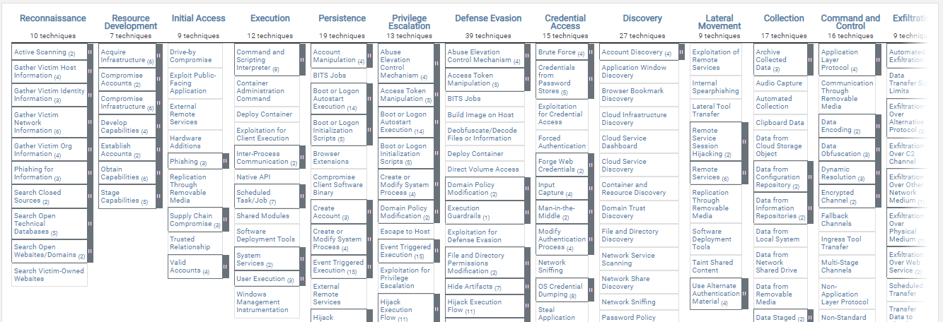
Threat Hunting framework MITRE ATT&CK
State of the art
Architecture of The Target Solution
Realization and Implementation
Solution Experimentation
Conclusion and Perspectives
Accessible knowledge base of adversary tactics and techniques
Enabling the sharing of conflicting behaviors throughout the attack lifecycle
Providing a common taxonomy for threat analysis and research
Constructing specialized threat models and approaches
Uniting groups together to produce more effective cybersecurity
The MITRE ATT&CK Enterprise Matrix consists of 14 tactics
9
Notes:
, based on real world observations

Slide 10
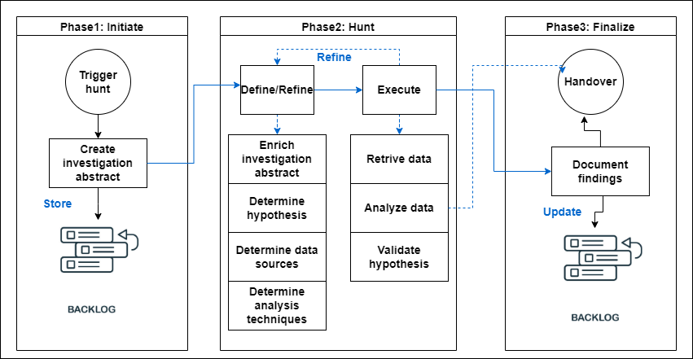
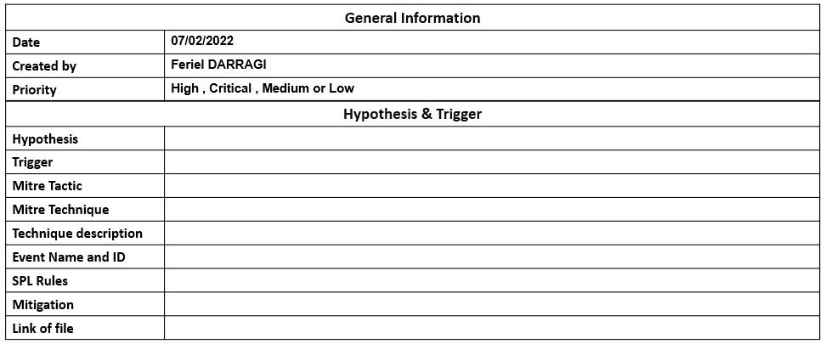
Threat Hunting playbook
State of the art
Architecture of The Target Solution
Realization and Implementation
Solution Experimentation
Conclusion and Perspectives
Targeted Hunting Integrating Threat Intelligence (TaHiTI) methodology
Template of threat hunting Playbook
10
Notes:
It appears that for every action an enterprise makes to secure itself from cyber-attacks, or for
every new anti-hacking tool developed, the hackers come up with something more intricate to
make it more dicult to defeat them.
Looking back over 20 years, the hackers that come to mind are amateur college kids. Gradually the field of piracy begins to evolve, for example in 1997 we find the ...
Then in 2004 we found
In the beginning of 2007 we started talking about
Just 3 years later, new concepts are introduced like
In these days, the cyber attack to evolve so that it affects all areas like banks, android devices, etc.
According to forbes magazine, The average number of cyberattacks and data breaches From 2020 To 2021 has evolved 15.1% of which 20% are malware and 22% are phishing attacks

Slide 11
Adversary Emulation tools comparative study
State of the art
Architecture of The Target Solution
Realization and Implementation
Solution Experimentation
Conclusion and Perspectives
 | Atomic Red Team | Metta | Mordor | CALDERA
coverage against MITRE ATT&CK tactics | 11 tactics of 14 tactics | 10 tactics of 14 tactics | 7 tactics of 14 tactics | 13 tactics of 14 tactics
Compatibility with MITRE TOOLS | NO | NO | NO | YES
Extensibility | NO | NO | NO | Extensible with Atomic Red Team and Mordor tools
Existence of a web interface | NO | NO | NO | YES
11
Notes:
It appears that for every action an enterprise makes to secure itself from cyber-attacks, or for
every new anti-hacking tool developed, the hackers come up with something more intricate to
make it more dicult to defeat them.
Looking back over 20 years, the hackers that come to mind are amateur college kids. Gradually the field of piracy begins to evolve, for example in 1997 we find the ...
Then in 2004 we found
In the beginning of 2007 we started talking about
Just 3 years later, new concepts are introduced like
In these days, the cyber attack to evolve so that it affects all areas like banks, android devices, etc.
According to forbes magazine, The average number of cyberattacks and data breaches From 2020 To 2021 has evolved 15.1% of which 20% are malware and 22% are phishing attacks

Slide 12
Configuration management and automation tools
State of the art
Architecture of The Target Solution
Realization and Implementation
Solution Experimentation
Conclusion and Perspectives
Definition
Used to facilitate and automate the task of deploying applications.
Install and prepare his work environment easily
Comparative Study of Configuration management and automation tools
 | Ansible | Chef | Puppet | SaltStack
Architecture deployment | Agentless | Client-server | Client-server | Client-server and Agentless
Language for system development | Python | Ruby | C++ | Python
License | GPLv3+ | Apache2.0 | Apache2.0 | Apache2.0
Transportation | SSH | RabbitMQ | Mcollective | ZeroMQ
Delivery Methods | Push | Pull | Pull | Push
Complexity of setting up | easy | Hardly easy | Hard | Hard
Supported OS | Linux,MacOS,BSD | IBM AIX, BSD, Linux, MacOSX, Solaris | Linux | Linux, MacOS, Unix, Windows
12
Notes:
It appears that for every action an enterprise makes to secure itself from cyber-attacks, or for
every new anti-hacking tool developed, the hackers come up with something more intricate to
make it more dicult to defeat them.
Looking back over 20 years, the hackers that come to mind are amateur college kids. Gradually the field of piracy begins to evolve, for example in 1997 we find the ...
Then in 2004 we found
In the beginning of 2007 we started talking about
Just 3 years later, new concepts are introduced like
In these days, the cyber attack to evolve so that it affects all areas like banks, android devices, etc.
According to forbes magazine, The average number of cyberattacks and data breaches From 2020 To 2021 has evolved 15.1% of which 20% are malware and 22% are phishing attacks

Slide 13
2.Architecture of The Target Solution
13
Notes:
It appears that for every action an enterprise makes to secure itself from cyber-attacks, or for
every new anti-hacking tool developed, the hackers come up with something more intricate to
make it more dicult to defeat them.
Looking back over 20 years, the hackers that come to mind are amateur college kids. Gradually the field of piracy begins to evolve, for example in 1997 we find the ...
Then in 2004 we found
In the beginning of 2007 we started talking about
Just 3 years later, new concepts are introduced like
In these days, the cyber attack to evolve so that it affects all areas like banks, android devices, etc.
According to forbes magazine, The average number of cyberattacks and data breaches From 2020 To 2021 has evolved 15.1% of which 20% are malware and 22% are phishing attacks

Slide 14
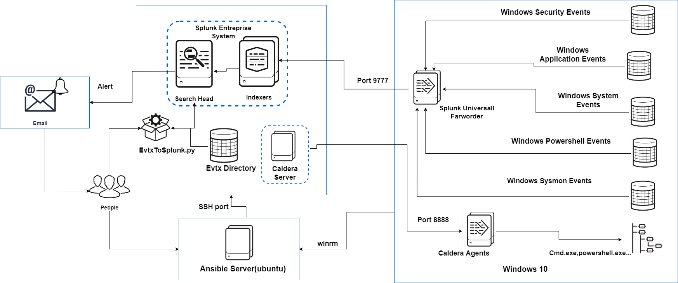
Architecture of The Target Solution
State of the art
Architecture of The Target Solution
Realization and Implementation
Solution Experimentation
Conclusion and Perspectives
14
Notes:
It appears that for every action an enterprise makes to secure itself from cyber-attacks, or for
every new anti-hacking tool developed, the hackers come up with something more intricate to
make it more dicult to defeat them.
Looking back over 20 years, the hackers that come to mind are amateur college kids. Gradually the field of piracy begins to evolve, for example in 1997 we find the ...
Then in 2004 we found
In the beginning of 2007 we started talking about
Just 3 years later, new concepts are introduced like
In these days, the cyber attack to evolve so that it affects all areas like banks, android devices, etc.
According to forbes magazine, The average number of cyberattacks and data breaches From 2020 To 2021 has evolved 15.1% of which 20% are malware and 22% are phishing attacks

Slide 15
3.Realization and Implementation
15
Notes:
It appears that for every action an enterprise makes to secure itself from cyber-attacks, or for
every new anti-hacking tool developed, the hackers come up with something more intricate to
make it more dicult to defeat them.
Looking back over 20 years, the hackers that come to mind are amateur college kids. Gradually the field of piracy begins to evolve, for example in 1997 we find the ...
Then in 2004 we found
In the beginning of 2007 we started talking about
Just 3 years later, new concepts are introduced like
In these days, the cyber attack to evolve so that it affects all areas like banks, android devices, etc.
According to forbes magazine, The average number of cyberattacks and data breaches From 2020 To 2021 has evolved 15.1% of which 20% are malware and 22% are phishing attacks

Slide 16
Realization and Implementation
State of the art
Architecture of The Target Solution
Realization and Implementation
Solution Experimentation
Conclusion and Perspectives
1
2
3
4
5
Installation and Configuration of Ansible
Configuration of agents
Script EVTX to Splunk
Configuration of Caldera Scenario
Investigation using Splunk and creation of rules
Playbooks:
Installation of Caldera Server
Installation of Splunk Server
Installation of Sysmon on the Client
Installation of Universal forwarder
Configuration of Splunk universal forwarder (Inputs.conf, Addon windows for splunk)
Configuration of Caldera agents(powershell Script)
Convert EVTX to json
Inject files to Splunk index=wineventlog
Parsing of fields
Creation of multiple Adversaries
Creation of multiple operations
Investigation using SPL..
Conception ,Creation and tunning of rule
16
Notes:
It appears that for every action an enterprise makes to secure itself from cyber-attacks, or for
every new anti-hacking tool developed, the hackers come up with something more intricate to
make it more dicult to defeat them.
Looking back over 20 years, the hackers that come to mind are amateur college kids. Gradually the field of piracy begins to evolve, for example in 1997 we find the ...
Then in 2004 we found
In the beginning of 2007 we started talking about
Just 3 years later, new concepts are introduced like
In these days, the cyber attack to evolve so that it affects all areas like banks, android devices, etc.
According to forbes magazine, The average number of cyberattacks and data breaches From 2020 To 2021 has evolved 15.1% of which 20% are malware and 22% are phishing attacks

Slide 17
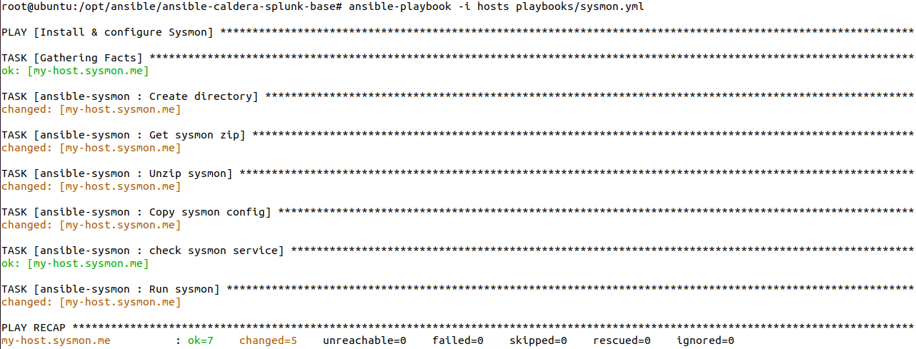
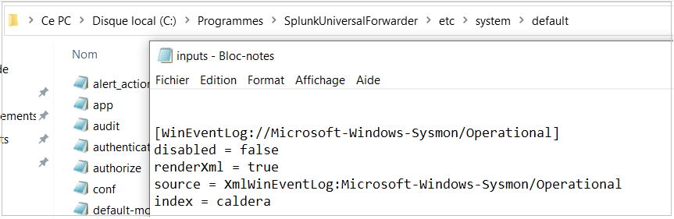
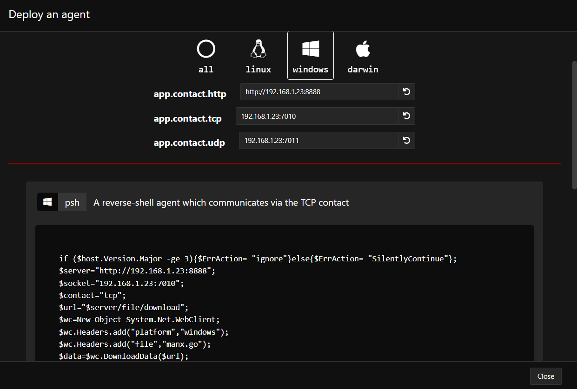
Realization and Implementation
State of the art
Architecture of The Target Solution
Realization and Implementation
Solution Experimentation
Conclusion and Perspectives
Example of Sysmon playbook
Example of Configuration of agents
17
Notes:
It appears that for every action an enterprise makes to secure itself from cyber-attacks, or for
every new anti-hacking tool developed, the hackers come up with something more intricate to
make it more dicult to defeat them.
Looking back over 20 years, the hackers that come to mind are amateur college kids. Gradually the field of piracy begins to evolve, for example in 1997 we find the ...
Then in 2004 we found
In the beginning of 2007 we started talking about
Just 3 years later, new concepts are introduced like
In these days, the cyber attack to evolve so that it affects all areas like banks, android devices, etc.
According to forbes magazine, The average number of cyberattacks and data breaches From 2020 To 2021 has evolved 15.1% of which 20% are malware and 22% are phishing attacks

Slide 18
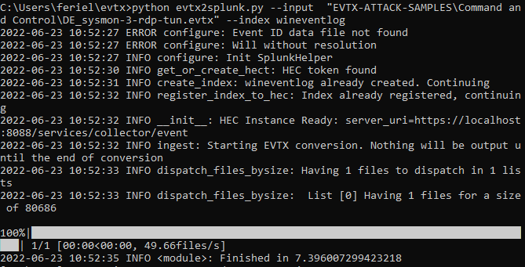
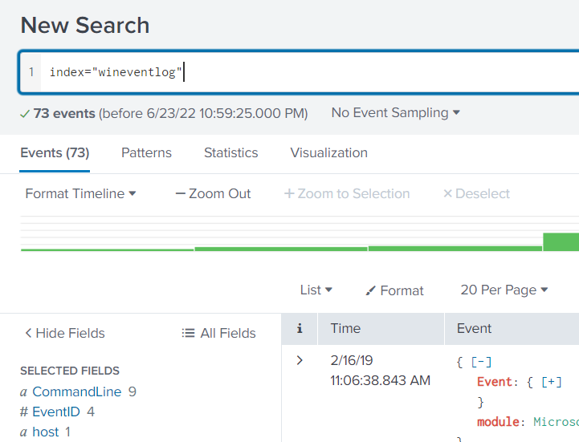
Realization and Implementation
State of the art
Architecture of The Target Solution
Realization and Implementation
Solution Experimentation
Conclusion and Perspectives
Script EVTX to Splunk
Result of Run of Script EVTX to SPLUNK
18
Notes:
It appears that for every action an enterprise makes to secure itself from cyber-attacks, or for
every new anti-hacking tool developed, the hackers come up with something more intricate to
make it more dicult to defeat them.
Looking back over 20 years, the hackers that come to mind are amateur college kids. Gradually the field of piracy begins to evolve, for example in 1997 we find the ...
Then in 2004 we found
In the beginning of 2007 we started talking about
Just 3 years later, new concepts are introduced like
In these days, the cyber attack to evolve so that it affects all areas like banks, android devices, etc.
According to forbes magazine, The average number of cyberattacks and data breaches From 2020 To 2021 has evolved 15.1% of which 20% are malware and 22% are phishing attacks

Slide 19
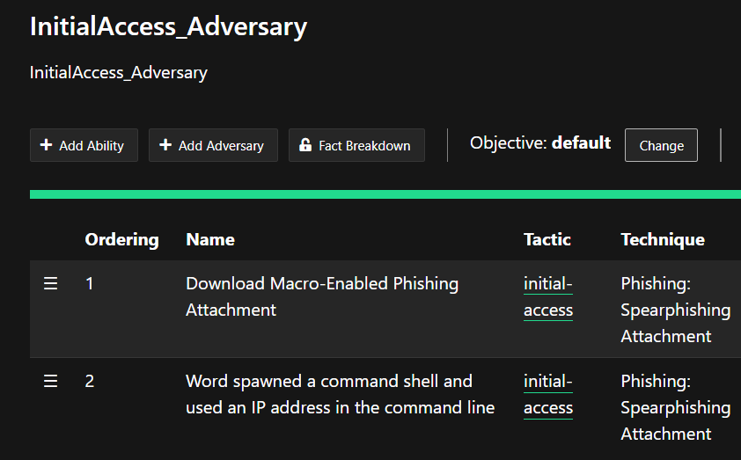
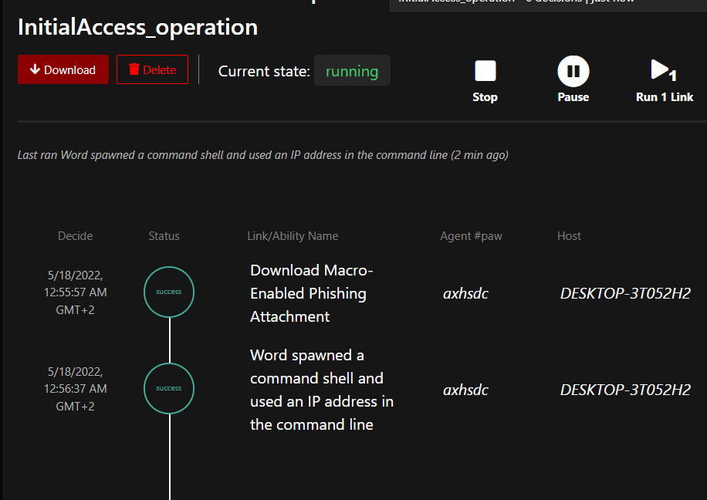
Realization and Implementation
State of the art
Architecture of The Target Solution
Realization and Implementation
Solution Experimentation
Conclusion and Perspectives
Example of configuration of an adversary (CALDERA)
Example of configuration of an operation (CALDERA)
19
Notes:
It appears that for every action an enterprise makes to secure itself from cyber-attacks, or for
every new anti-hacking tool developed, the hackers come up with something more intricate to
make it more dicult to defeat them.
Looking back over 20 years, the hackers that come to mind are amateur college kids. Gradually the field of piracy begins to evolve, for example in 1997 we find the ...
Then in 2004 we found
In the beginning of 2007 we started talking about
Just 3 years later, new concepts are introduced like
In these days, the cyber attack to evolve so that it affects all areas like banks, android devices, etc.
According to forbes magazine, The average number of cyberattacks and data breaches From 2020 To 2021 has evolved 15.1% of which 20% are malware and 22% are phishing attacks

Slide 20
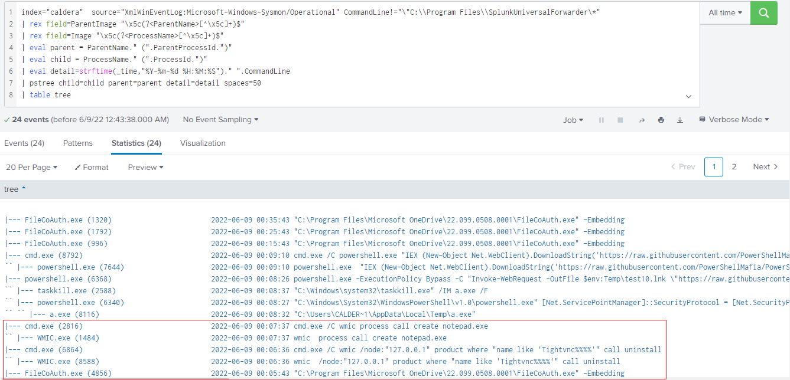
Realization and Implementation
State of the art
Architecture of The Target Solution
Realization and Implementation
Solution Experimentation
Conclusion and Perspectives
Example of investigation an execution Attacks
20
Notes:
It appears that for every action an enterprise makes to secure itself from cyber-attacks, or for
every new anti-hacking tool developed, the hackers come up with something more intricate to
make it more dificult to defeat them.
Looking back over 20 years, the hackers that come to mind are amateur college kids. Gradually the field of piracy begins to evolve, for example in 1997 we find the ...
Then in 2004 we found
In the beginning of 2007 we started talking about
Just 3 years later, new concepts are introduced like
In these days, the cyber attack to evolve so that it affects all areas like banks, android devices, etc.
According to forbes magazine, The average number of cyberattacks and data breaches From 2020 To 2021 has evolved 15.1% of which 20% are malware and 22% are phishing attacks

Slide 21
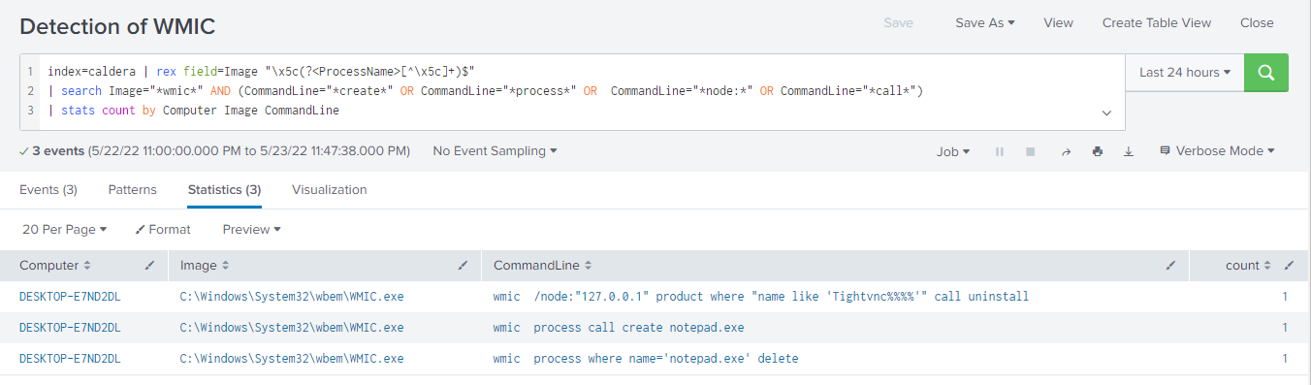
Realization and Implementation
State of the art
Architecture of The Target Solution
Realization and Implementation
Solution Experimentation
Conclusion and Perspectives
Example of correlation rule: Detection of Application uninstall using WMIC Attack
21
Notes:
It appears that for every action an enterprise makes to secure itself from cyber-attacks, or for
every new anti-hacking tool developed, the hackers come up with something more intricate to
make it more dificult to defeat them.
Looking back over 20 years, the hackers that come to mind are amateur college kids. Gradually the field of piracy begins to evolve, for example in 1997 we find the ...
Then in 2004 we found
In the beginning of 2007 we started talking about
Just 3 years later, new concepts are introduced like
In these days, the cyber attack to evolve so that it affects all areas like banks, android devices, etc.
According to forbes magazine, The average number of cyberattacks and data breaches From 2020 To 2021 has evolved 15.1% of which 20% are malware and 22% are phishing attacks

Slide 22
4.Solution Experimentation
22
Notes:
It appears that for every action an enterprise makes to secure itself from cyber-attacks, or for
every new anti-hacking tool developed, the hackers come up with something more intricate to
make it more dicult to defeat them.
Looking back over 20 years, the hackers that come to mind are amateur college kids. Gradually the field of piracy begins to evolve, for example in 1997 we find the ...
Then in 2004 we found
In the beginning of 2007 we started talking about
Just 3 years later, new concepts are introduced like
In these days, the cyber attack to evolve so that it affects all areas like banks, android devices, etc.
According to forbes magazine, The average number of cyberattacks and data breaches From 2020 To 2021 has evolved 15.1% of which 20% are malware and 22% are phishing attacks

Slide 23
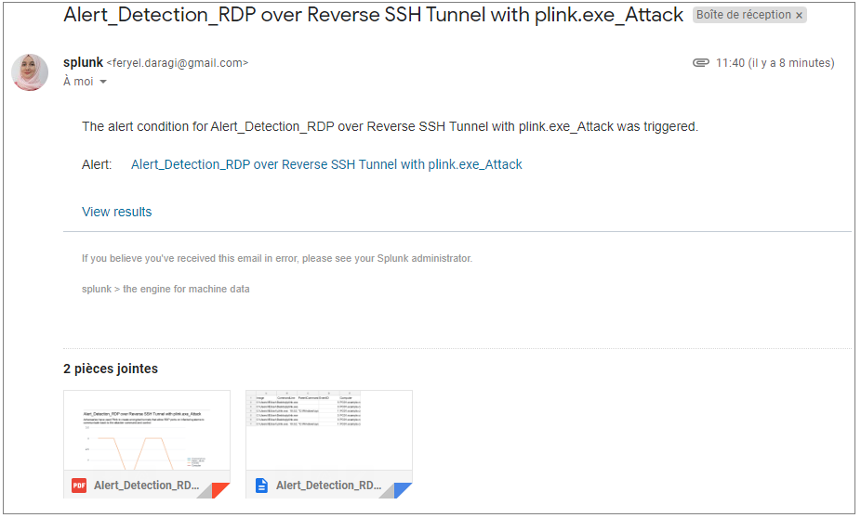
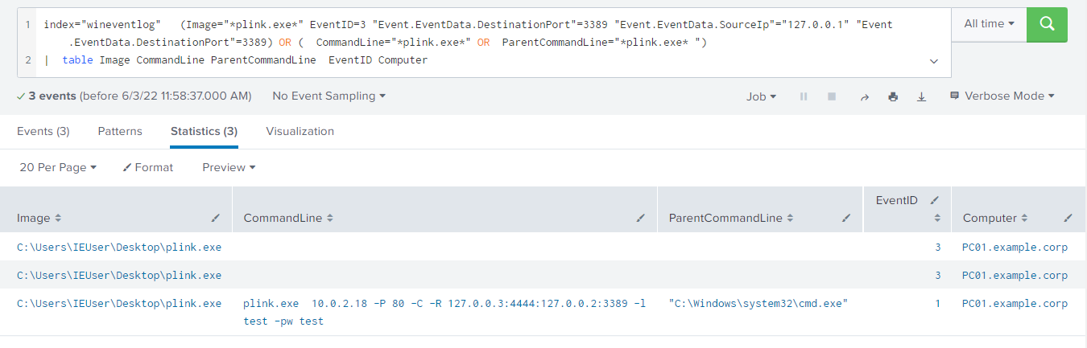
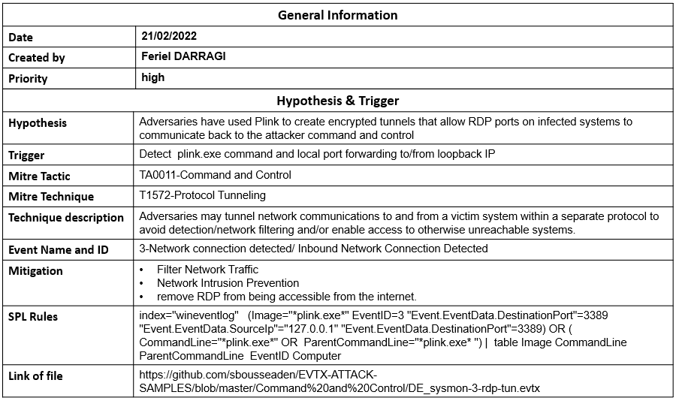
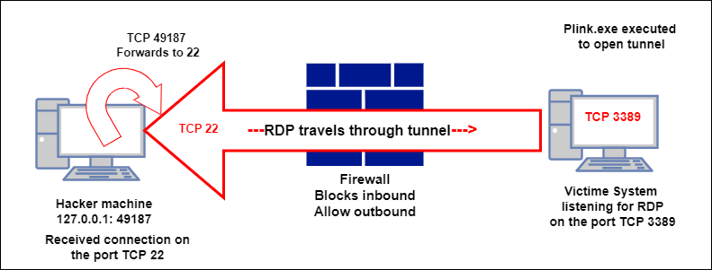
Solution Experimentation
State of the art
Architecture of The Target Solution
Realization and Implementation
Solution Experimentation
Conclusion and Perspectives
Validation of use Case EVTX
Scenario of RDP over Reverse SSH Tunnel with plink.exe attack
23
Notes:
It appears that for every action an enterprise makes to secure itself from cyber-attacks, or for
every new anti-hacking tool developed, the hackers come up with something more intricate to
make it more dicult to defeat them.
Looking back over 20 years, the hackers that come to mind are amateur college kids. Gradually the field of piracy begins to evolve, for example in 1997 we find the ...
Then in 2004 we found
In the beginning of 2007 we started talking about
Just 3 years later, new concepts are introduced like
In these days, the cyber attack to evolve so that it affects all areas like banks, android devices, etc.
According to forbes magazine, The average number of cyberattacks and data breaches From 2020 To 2021 has evolved 15.1% of which 20% are malware and 22% are phishing attacks

Slide 24
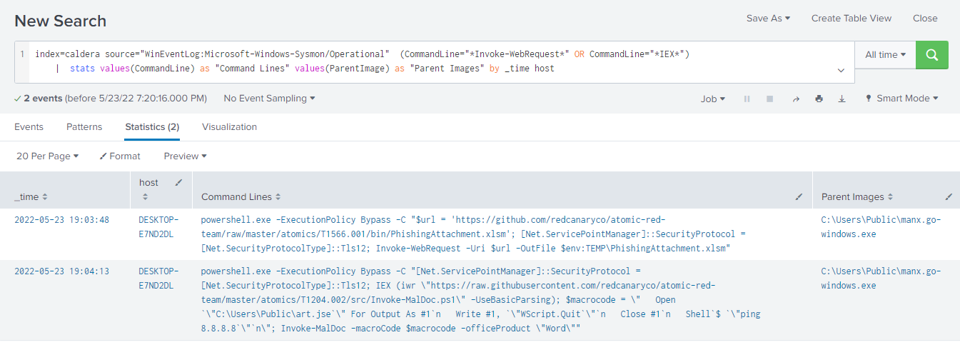
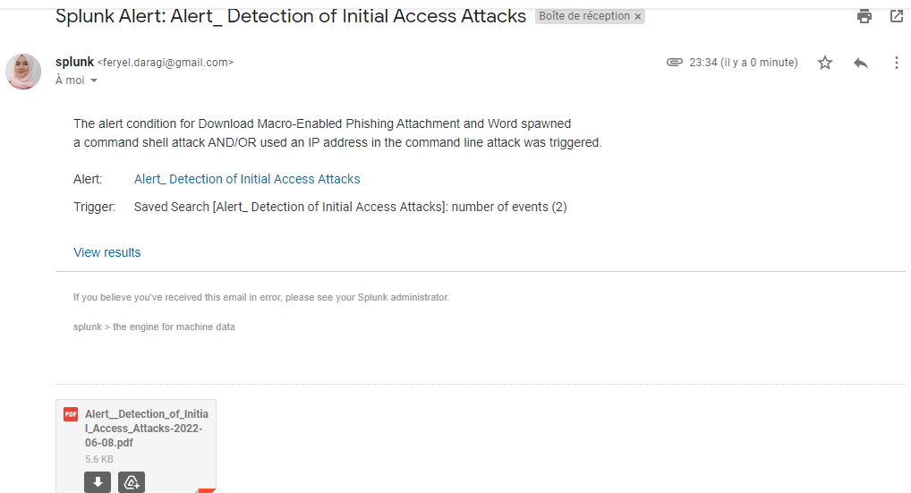
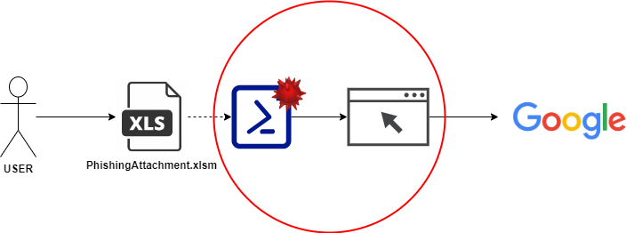
Solution Experimentation
State of the art
Architecture of The Target Solution
Realization and Implementation
Solution Experimentation
Conclusion and Perspectives
Validation of use Case Caldera
Scenario of Download Macro-Enabled Phishing Attachment attack
24
Notes:
It appears that for every action an enterprise makes to secure itself from cyber-attacks, or for
every new anti-hacking tool developed, the hackers come up with something more intricate to
make it more dicult to defeat them.
Looking back over 20 years, the hackers that come to mind are amateur college kids. Gradually the field of piracy begins to evolve, for example in 1997 we find the ...
Then in 2004 we found
In the beginning of 2007 we started talking about
Just 3 years later, new concepts are introduced like
In these days, the cyber attack to evolve so that it affects all areas like banks, android devices, etc.
According to forbes magazine, The average number of cyberattacks and data breaches From 2020 To 2021 has evolved 15.1% of which 20% are malware and 22% are phishing attacks

Slide 25
5. Conclusion and perspectives
25
Notes:
It appears that for every action an enterprise makes to secure itself from cyber-attacks, or for
every new anti-hacking tool developed, the hackers come up with something more intricate to
make it more dicult to defeat them.
Looking back over 20 years, the hackers that come to mind are amateur college kids. Gradually the field of piracy begins to evolve, for example in 1997 we find the ...
Then in 2004 we found
In the beginning of 2007 we started talking about
Just 3 years later, new concepts are introduced like
In these days, the cyber attack to evolve so that it affects all areas like banks, android devices, etc.
According to forbes magazine, The average number of cyberattacks and data breaches From 2020 To 2021 has evolved 15.1% of which 20% are malware and 22% are phishing attacks

Slide 26
State of the art
Architecture of The Target Solution
Realization and Implementation
Solution Experimentation
Conclusion and Perspectives
Conclusion and perspectives
Saving time by
automating
installations with Ansible
1
Proving the importance
of using Threat
Hunting methodologies with SIEM solutions
2
Conclusion
Emulating adversaries plans
3
65 use cases (52
techniques are covered and
11 tactics are covered)
4

Slide 27
State of the art
Architecture of The Target Solution
Realization and Implementation
Solution Experimentation
Conclusion and Perspectives
Conclusion and perspectives
Mapping Active Directory attacks
1
Automate
the configuration
of agents to gain
time and cost
2
Perspectives
Automate the registration of correlation rules
3
Developing a web application to manage rules
4

Slide 28
THANK YOU FOR YOUR ATTENTION

